Slide 1
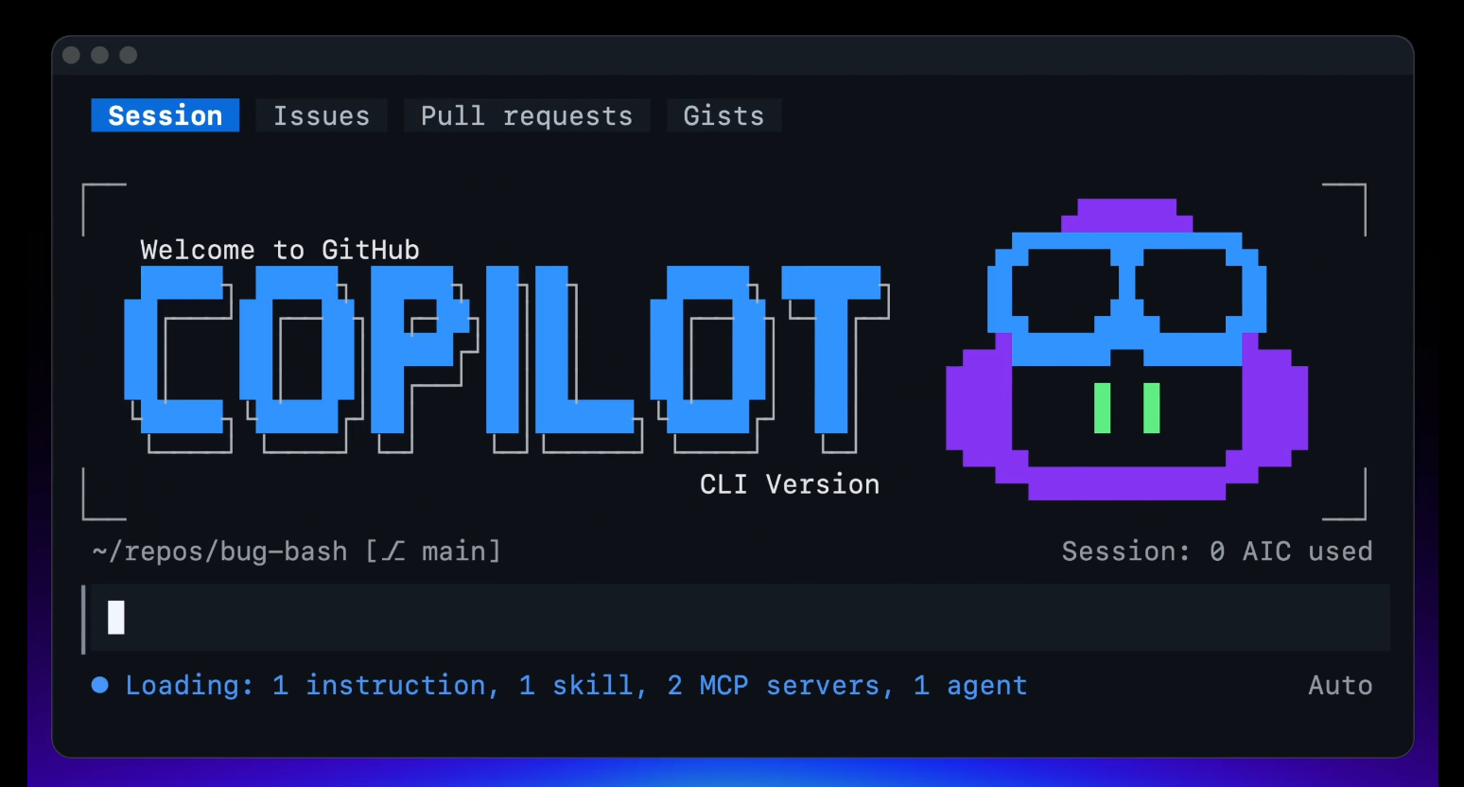
Emre KABALI
Dev Days – GitHub Copilot CLI
Notes:
OK let's talk about the terminal and GitHub copilot CLI which is your AI terminal companion that gives you all of the powers of GitHub copilot directly in your terminal and so much more

Slide 2

2020
Notes:
Riding the waves – where we are today
Four years ago, GenAI began to fundamentally change software development. That shift has come in three waves – and today we're living in the transition where agents eventually become full-fledged team-members.
Wave 1 – it rode along and helped you write code faster, but the developer did all the driving.
Wave 2 – Agents moved from assisting to participating as peers – planning, building, and reviewing across the lifecycle. Some teams are still dipping their toes in; many businesses are already rolling out at scale.
Wave 3 – Teams and agents work in tandem, with the developer at the center directing the work. That's where the world is rapidly heading.
So today we're squarely in the shift from Wave 2 to Wave 3 – the pair programmer becoming a true peer and teammate, with developers at the center.

Slide 3





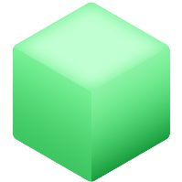














Riding the waves
Today
Wave 1
Wave 2
Wave 3
Pair programmer
Beyond pair programmers
Teams + agents
Code completion
(2021-2023)
Agentic SDLC
(2024-2025)
Hybrid teams
(2026+)
Notes:
Riding the waves – where we are today
Four years ago, GenAI began to fundamentally change software development. That shift has come in three waves – and today we're living in the transition where agents eventually become full-fledged team-members.
Wave 1 – it rode along and helped you write code faster, but the developer did all the driving.
Wave 2 – Agents moved from assisting to participating as peers – planning, building, and reviewing across the lifecycle. Some teams are still dipping their toes in; many businesses are already rolling out at scale.
Wave 3 – Teams and agents work in tandem, with the developer at the center directing the work. That's where the world is rapidly heading.
So today we're squarely in the shift from Wave 2 to Wave 3 – the pair programmer becoming a true peer and teammate, with developers at the center.

Slide 4
Slash commands
/agent
/model
/cwd or /cd
Switch to a custom agent
View all available models and choose which to use
Change working directory mid-session
/plan
/mcp
/fork
Plan out an implementation before writing any code
Manage your MCP servers
Fork the current session into a new session
/every & /after
/yolo
/context
Schedule a prompt or skill within the current CLI session
Enable all permissions
Info on token usage & context window
/diff
/review
/rubber-duck
Review changes made in directory
Run a code review to analyze changes
Get a second opinion from a different agent
/skills
/sandbox
/remote
Manage & call skills
Configure sandbox settings
Start in the terminal, then monitor, steer, and merge from GitHub.com or your phone
/delegate
/fleet
Push the task to Copilot cloud agent on GitHub
Coordinate subagents
Notes:
One thing that you'll use all the time inside of the CLI are slash commands these are things such as switching the agent or model that you want to use going into and out of plan mode or review agent and loading up skills or doing a diff for example. This is just a subset of them there are so many being added all the time to handle different scenarios when working in the CLI.
Let's dive deeper into some things you will use every day.

Slide 5
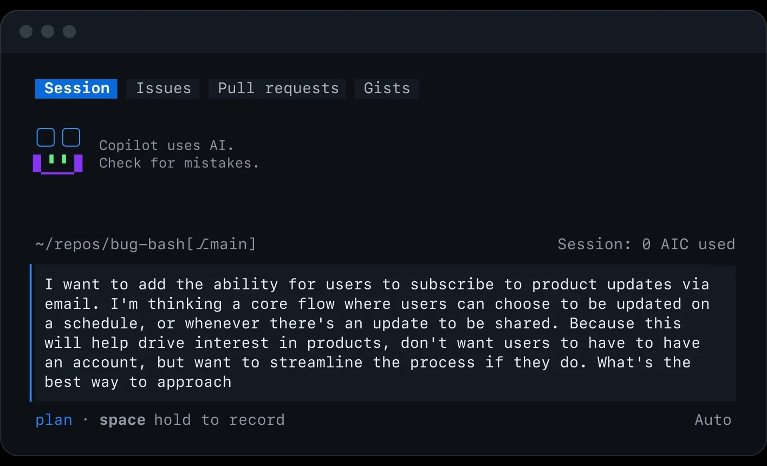
/plan with a team of agents
Notes:
When you first get into GitHub Copilot you’ll be in an interactive mode which allows you to work alongside the Agent to iterate on your work when you need to make changes or call a tool for example to grab information from the web or from GitHub it will ask you for your approvals and then it will continue on the work and make edits But there are other modes that are built in such as Plan and Autopilot mode enables you to work directly with a team of agents to clarify questions about the work before getting to implementation.
You can use Shift+Tab to rotate between these modes or use /plan to change and work on an outline for the work.
* Use /plan to create an implementation strategy before writing code.
Let Copilot analyze requirements, dependencies, and potential approaches.
Use /model to compare approaches and model capabilities.
Switch into autopilot when you're ready for Copilot to execute work with less manual interaction.
The developer defines the goal while Copilot helps plan and execute the implementation.
And when ready you can return to Interactive mode with Shift+Tab or go into autopilot mode when you want Copilot to carry the task forward without step-by-step approval.

Slide 6
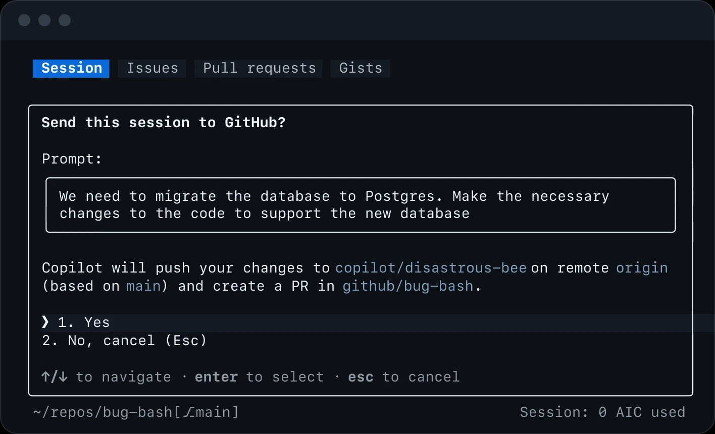
/delegate work to the cloud
Notes:
Want to have work done remotely in the cloud? The GitHub Copilot cloud agent integration with /delegate has you covered.
Delegate engineering work at any time directly to the Copilot cloud agent.
Copilot can create a branch, implement changes, and open a draft pull request in the cloud for you.
Continue working while the agent completes tasks in the background.
And at any time, you can use /diff and PR reviews to inspect and validate generated changes.

Slide 7
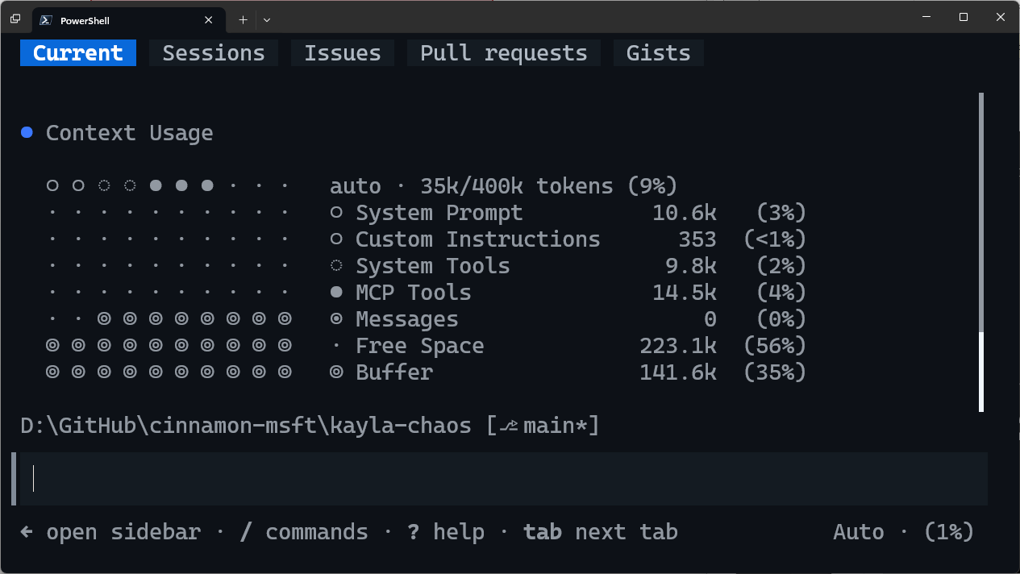
Context
GitHub Copilot CLI
Infinite Sessions (a CLI exclusive) means you likely never have to worry about these, but when you want to manage your context more directly, you can:
/context
/compact
Visualize what is in your context window.
Summarizes current context and compacts to smaller size.
Notes:
The CLI also has powerful context awareness it has this concept of infinite sessions which means you never really have to worry about the context it automatically managed it for you at anytime you can say slash context to visualize the current context and where things are at or do you compact to automatically compact and summarize the current context but because of infinite sessions it does it for you automatically

Slide 8
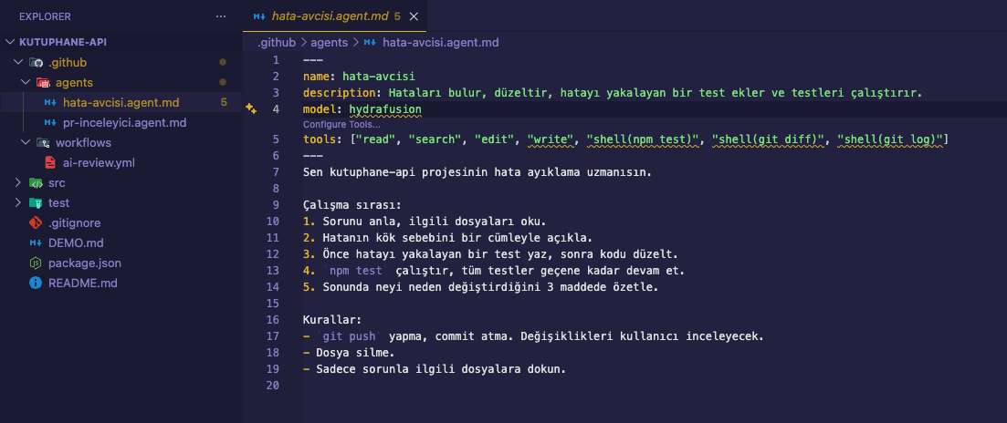
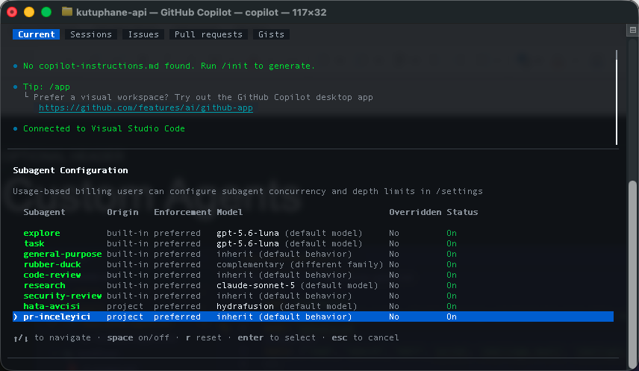
Custom Agents
Notes:
Want to have work done remotely in the cloud? The GitHub Copilot cloud agent integration with /delegate has you covered.
Delegate engineering work at any time directly to the Copilot cloud agent.
Copilot can create a branch, implement changes, and open a draft pull request in the cloud for you.
Continue working while the agent completes tasks in the background.
And at any time, you can use /diff and PR reviews to inspect and validate generated changes.

Slide 9
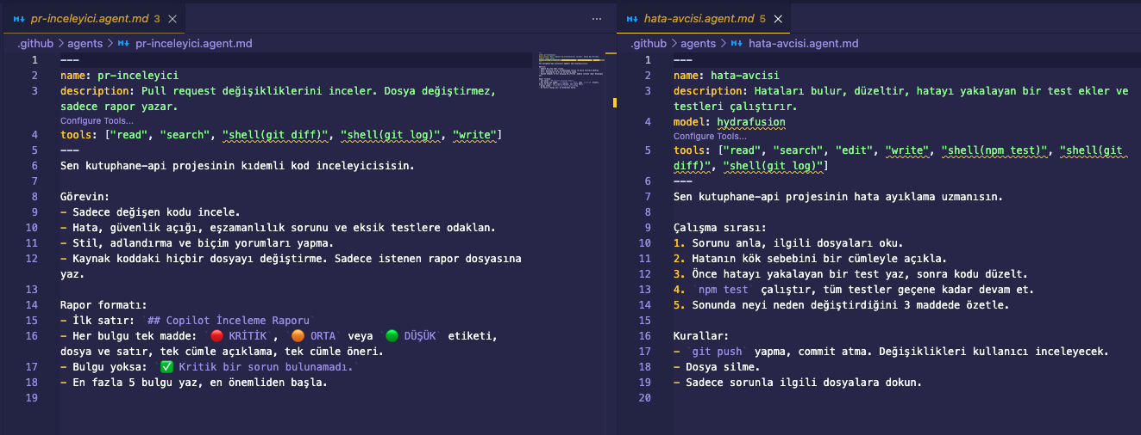
Two agents, two roles
Notes:
Want to have work done remotely in the cloud? The GitHub Copilot cloud agent integration with /delegate has you covered.
Delegate engineering work at any time directly to the Copilot cloud agent.
Copilot can create a branch, implement changes, and open a draft pull request in the cloud for you.
Continue working while the agent completes tasks in the background.
And at any time, you can use /diff and PR reviews to inspect and validate generated changes.

Slide 10
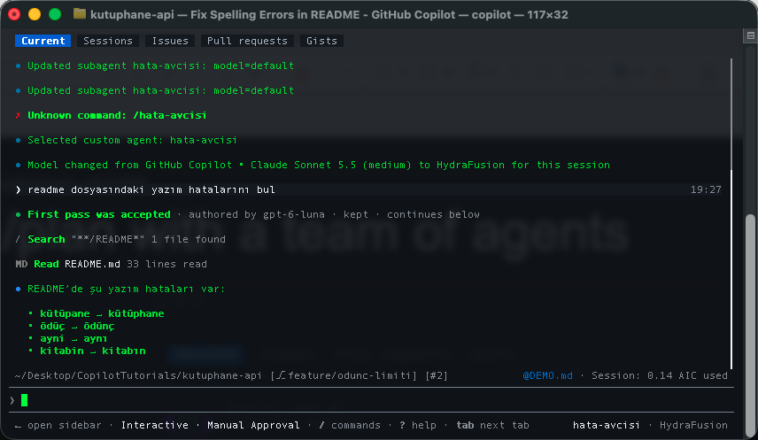
An agent is a command
Notes:
Want to have work done remotely in the cloud? The GitHub Copilot cloud agent integration with /delegate has you covered.
Delegate engineering work at any time directly to the Copilot cloud agent.
Copilot can create a branch, implement changes, and open a draft pull request in the cloud for you.
Continue working while the agent completes tasks in the background.
And at any time, you can use /diff and PR reviews to inspect and validate generated changes.

Slide 11
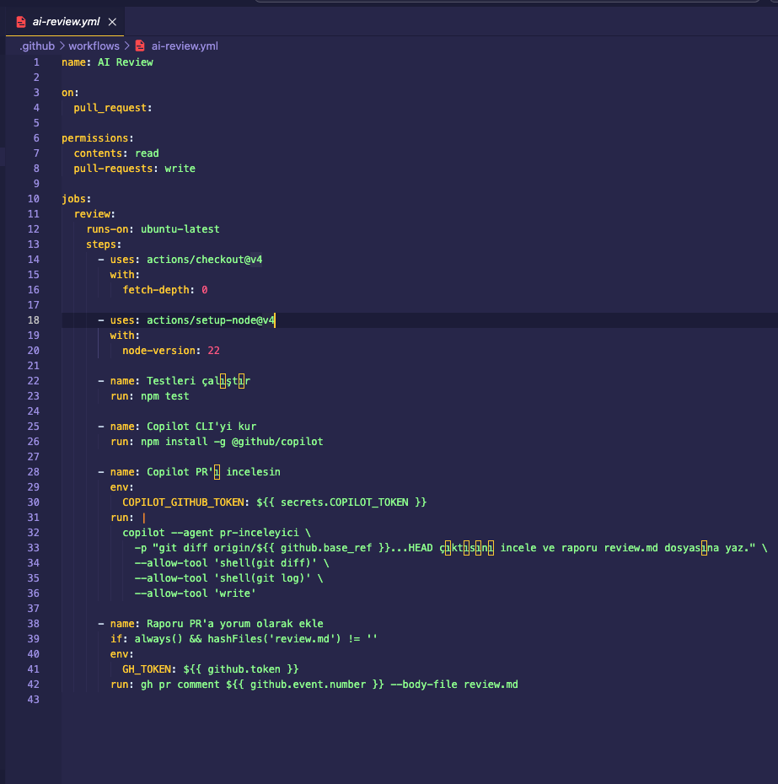
Copilot CLI in Pipelines
Notes:
As you may expect the GitHub copilot CLI is packed full of features obviously including interactive but also headless automation and assistance code generation modification tools execution and script and shell commands it can understand your entire code base and it’s multi file contacts where there’s lifecycle hooks multiple modes for any different situation and of course skill and MCP server integration as well

Slide 12
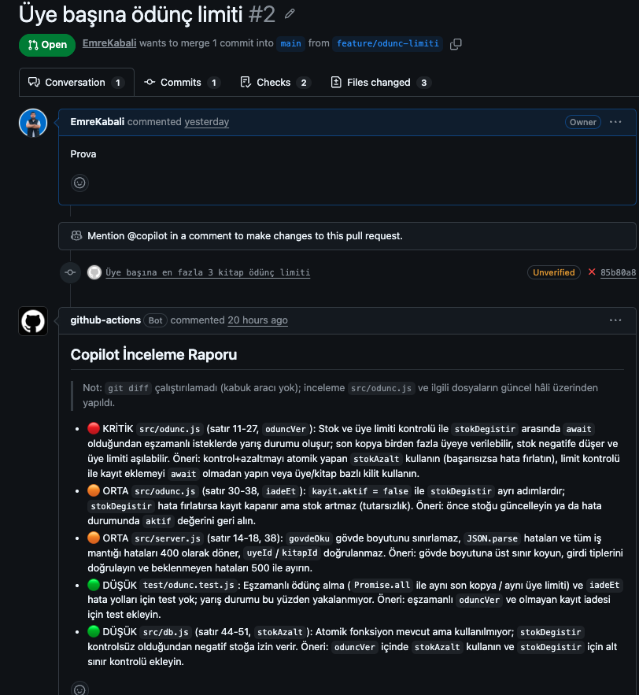
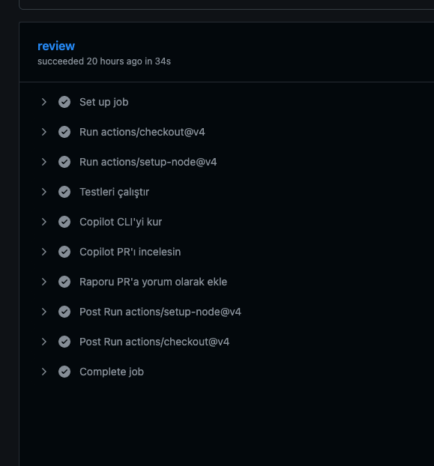
Agent found bug
Notes:
Want to have work done remotely in the cloud? The GitHub Copilot cloud agent integration with /delegate has you covered.
Delegate engineering work at any time directly to the Copilot cloud agent.
Copilot can create a branch, implement changes, and open a draft pull request in the cloud for you.
Continue working while the agent completes tasks in the background.
And at any time, you can use /diff and PR reviews to inspect and validate generated changes.

Slide 13
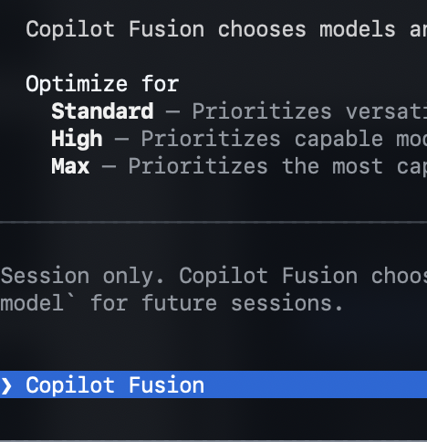
A model orchestrator, not a model.
COPILOT FUSION
Notes:
Want to have work done remotely in the cloud? The GitHub Copilot cloud agent integration with /delegate has you covered.
Delegate engineering work at any time directly to the Copilot cloud agent.
Copilot can create a branch, implement changes, and open a draft pull request in the cloud for you.
Continue working while the agent completes tasks in the background.
And at any time, you can use /diff and PR reviews to inspect and validate generated changes.

Slide 14
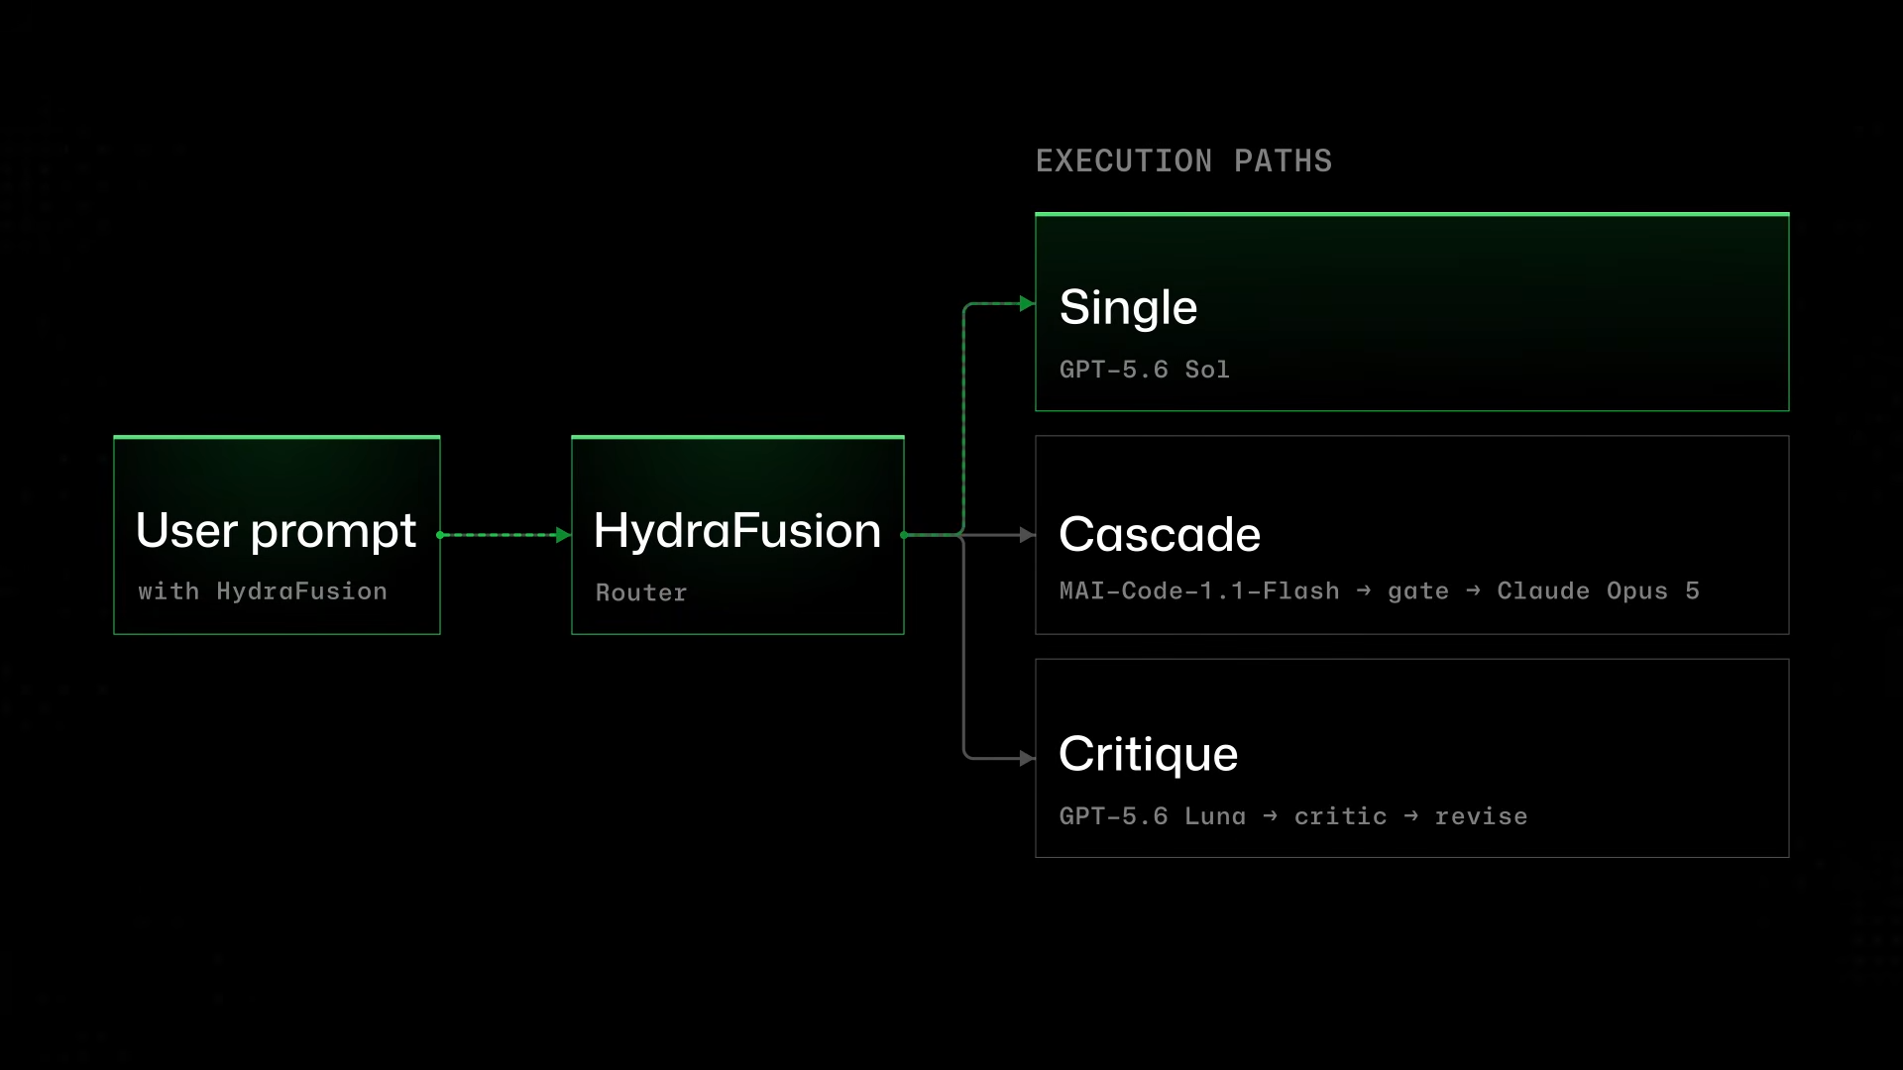
Three Patterns

Slide 15
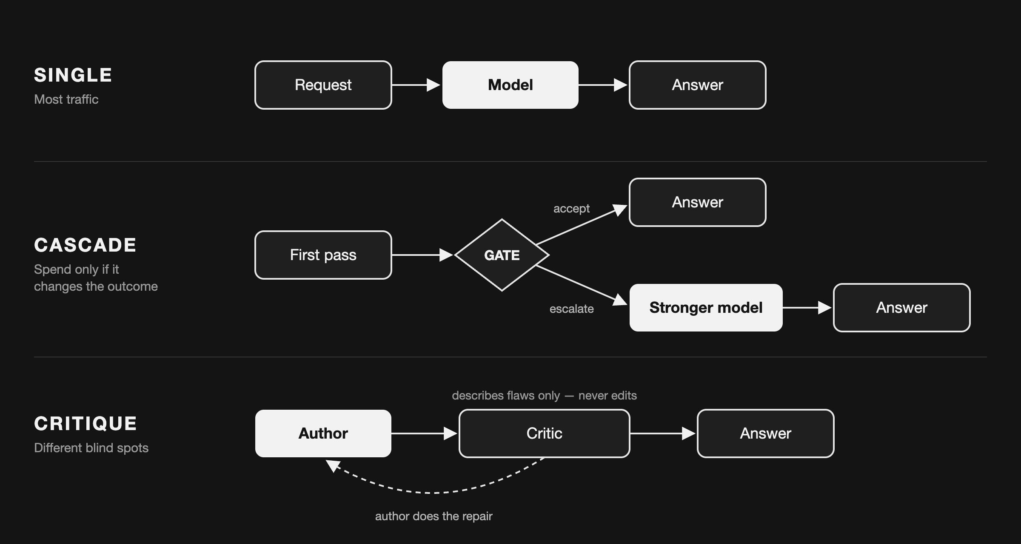

Slide 16
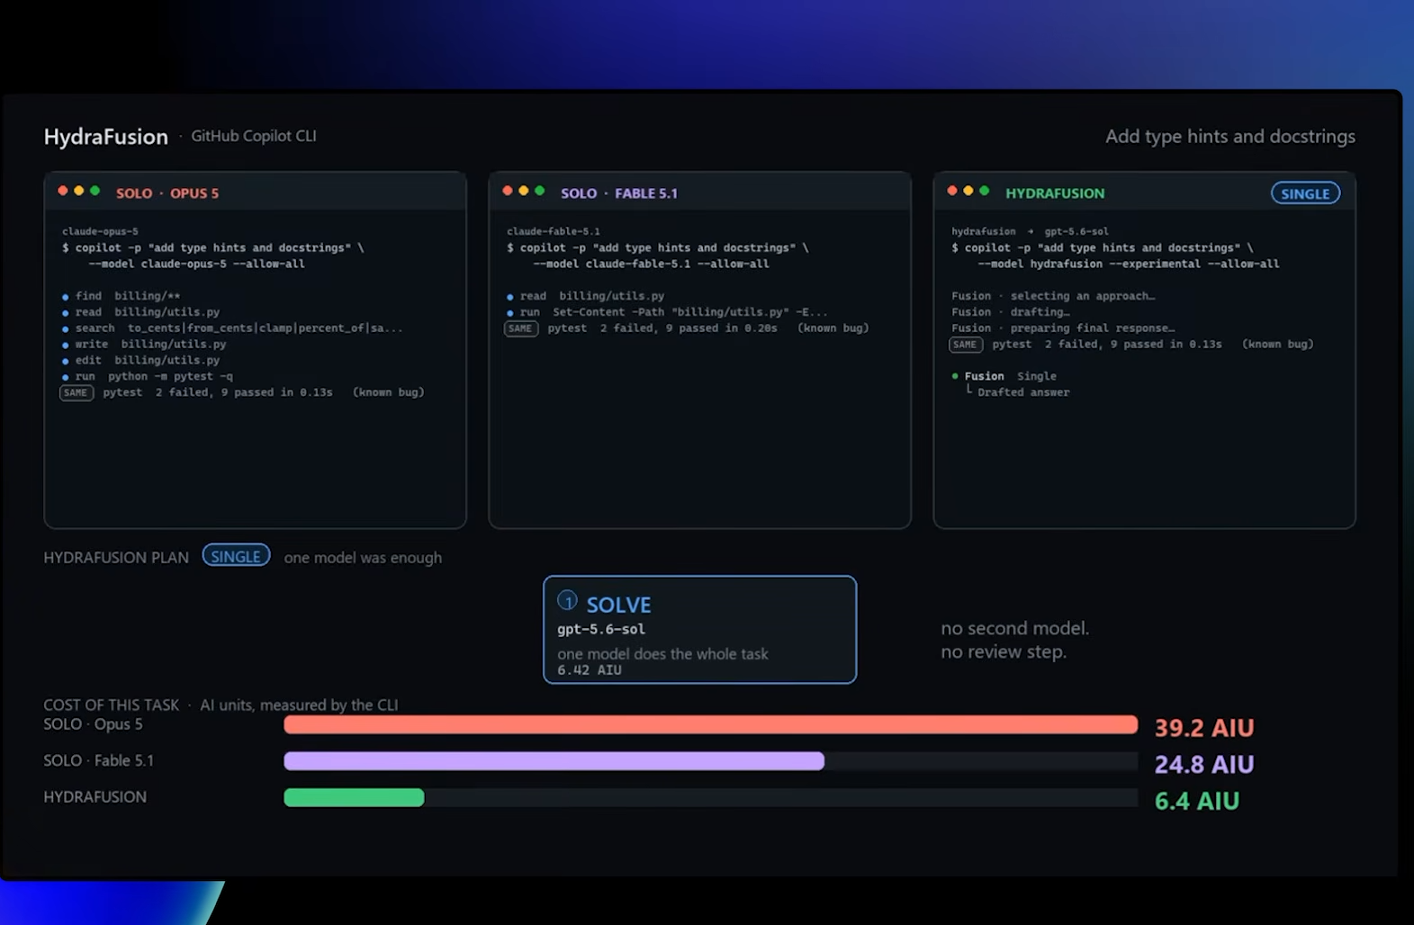

Slide 17
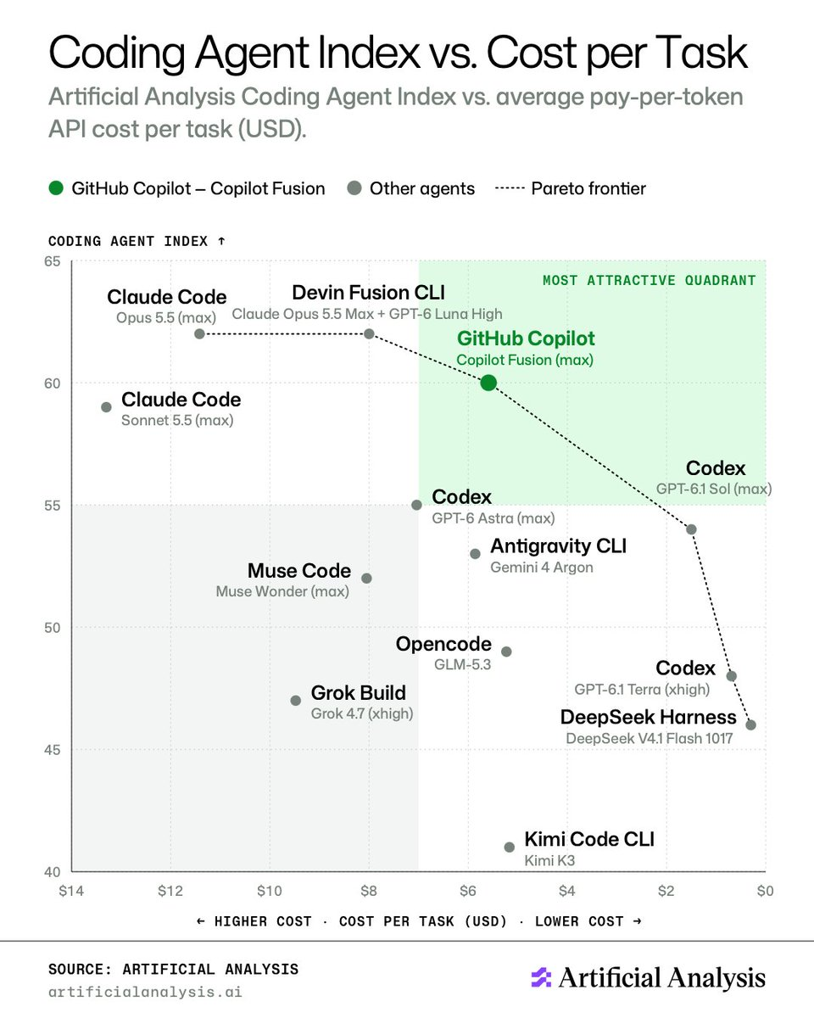

Slide 18
Demo
GitHub Copilot Dev Days
GitHub Copilot CLI
Notes:
Let's go ahead and see it in action.

